Slide 1
Research Report
Vo Khoi Thanh Son
31-5-2024

Slide 2
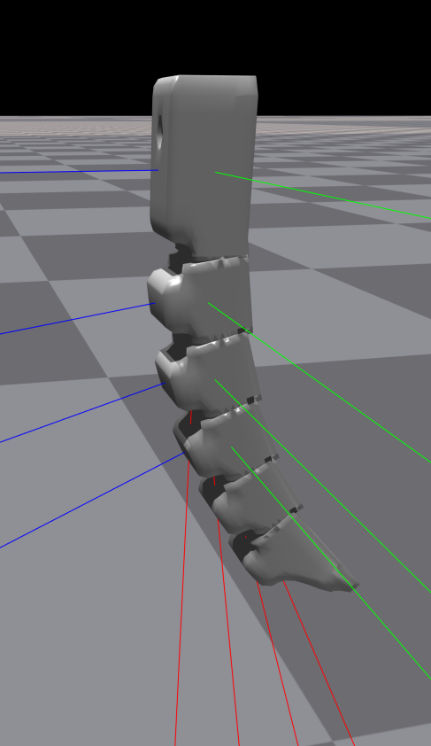


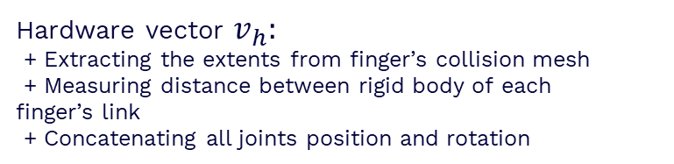
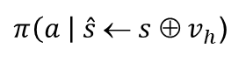
Previous work
- Update on constructing hardware vector for 3-fingered 4-mid gripper with different scale
Hardware vector $v_{h}:$
+ Extracting the extents from finger’s collision mesh
+ Measuring distance between rigid body of each finger’s link
+ Concatenating all joints position and rotation
→ Measure relative distance $d_{i}$ between 2 last joints
(self._q[:, 10]-self._q[:, 9])
$$d_{i}$$
$$$$
(self._q[:, 15]-self._q[:, 14])
(self._q[:, 20]-self._q[:, 19])
$π\left(a \right| \hat{s} ← s ⊕ v_{h}$)

Slide 3
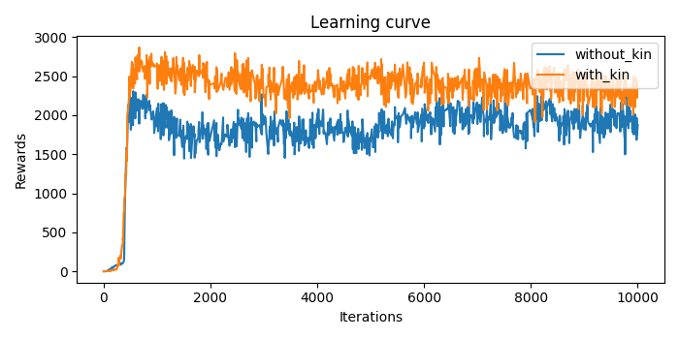
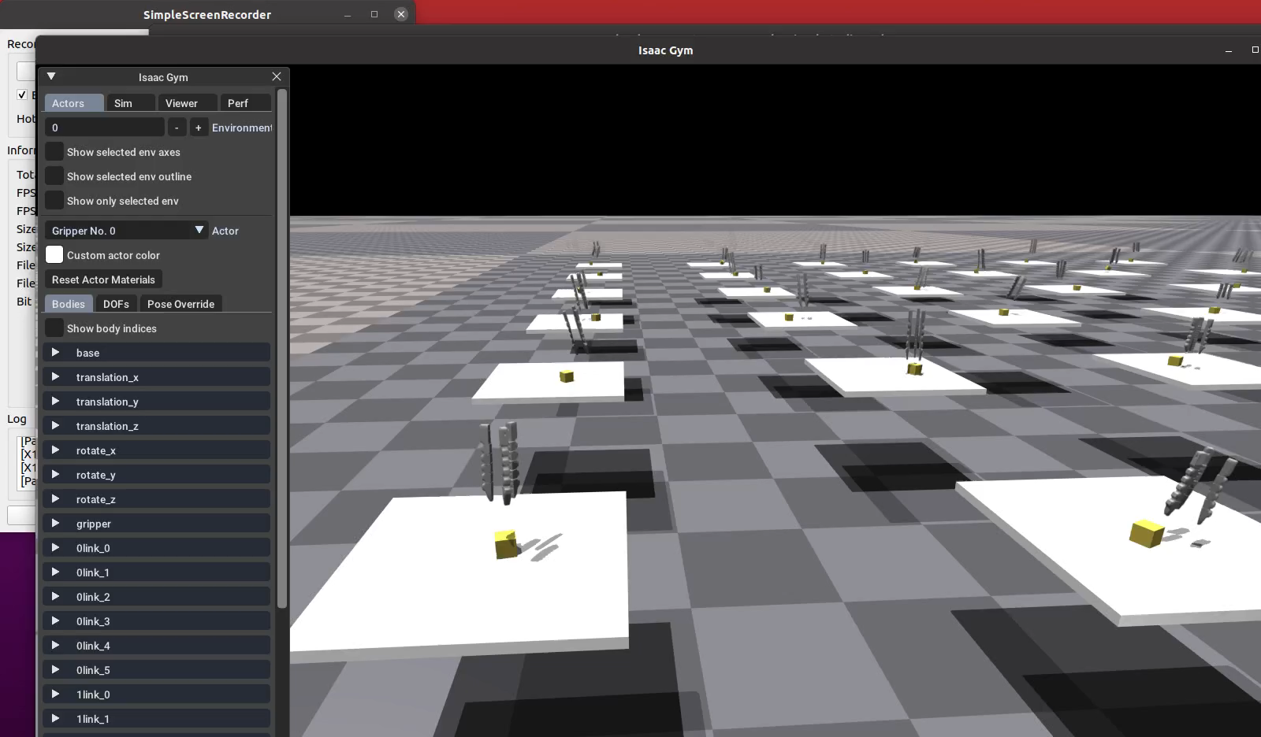
Gripper performance
3-fingered gripper with hardware vector
Comparison between with and without kinematic properties
→ Apply the hardware vector to other types of grippers

Slide 4
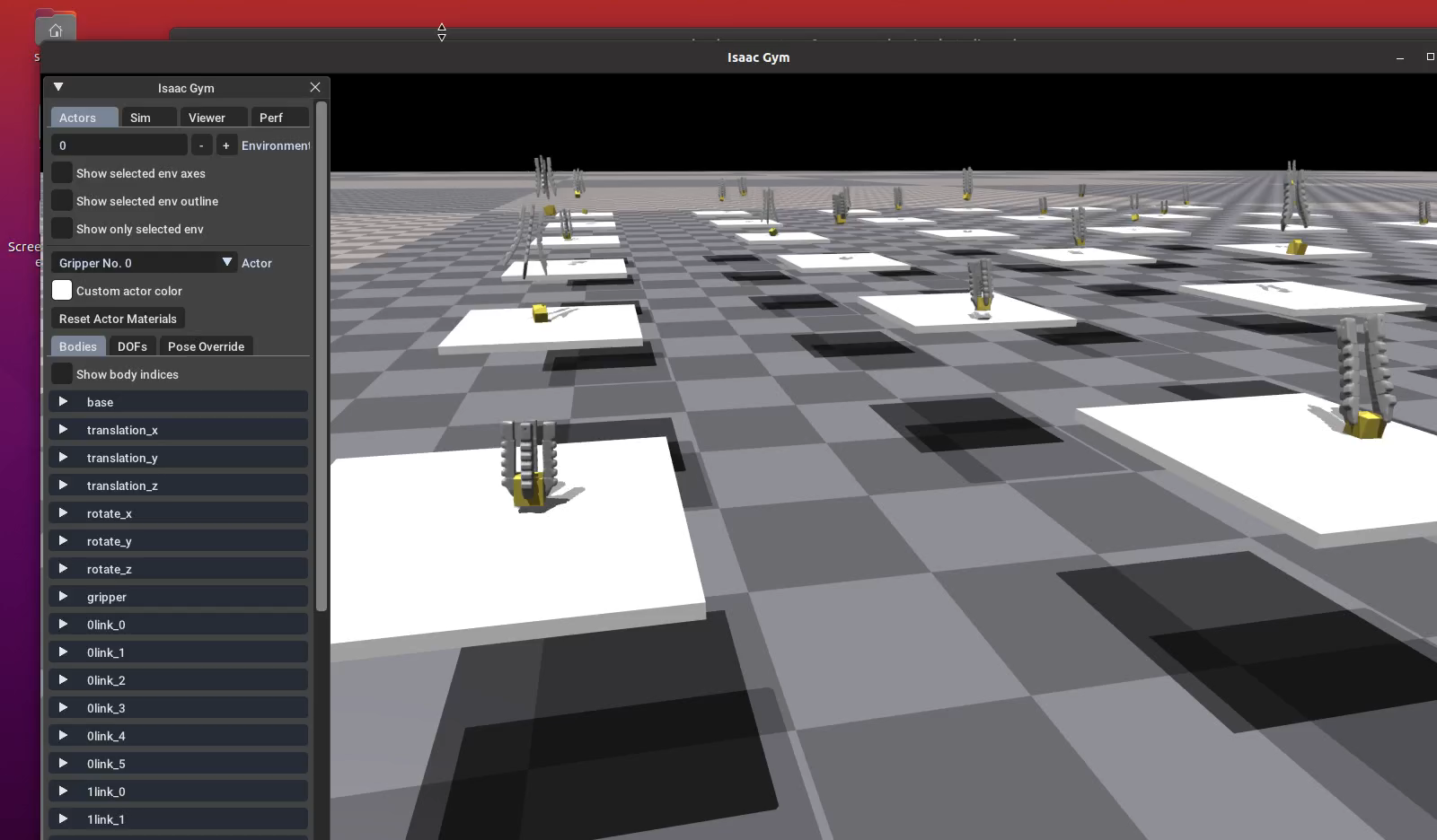
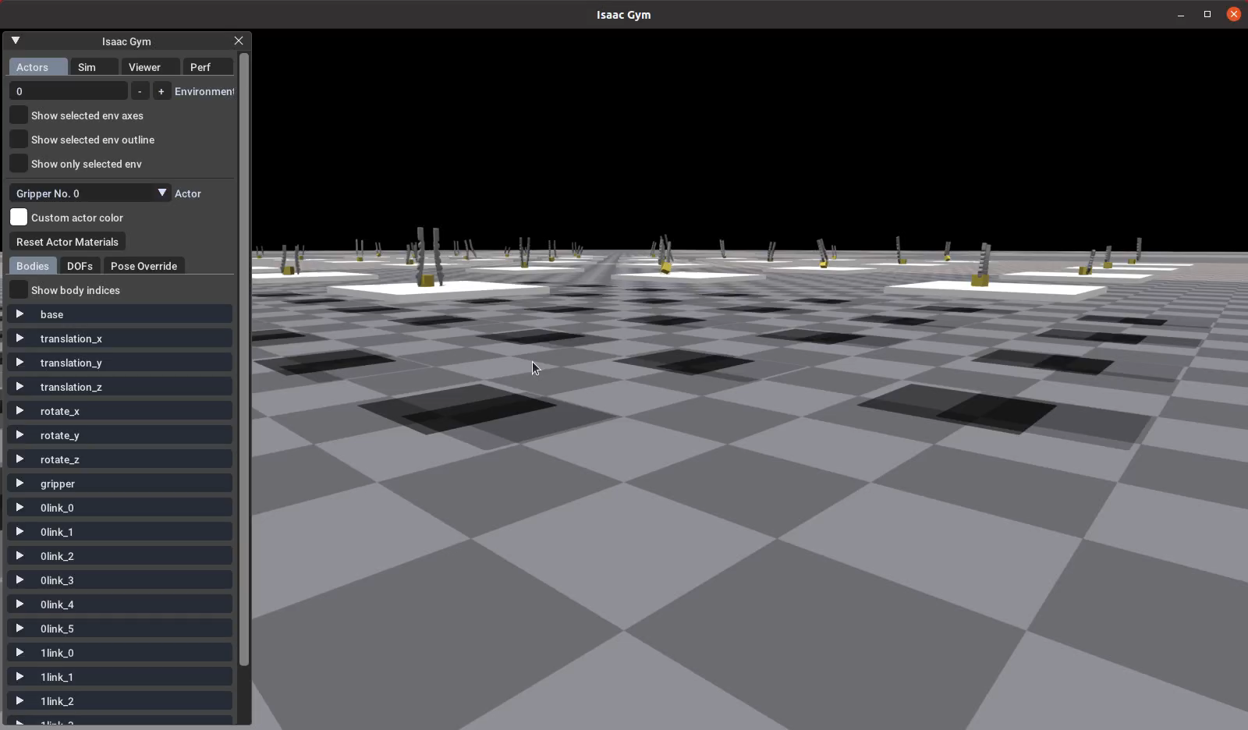
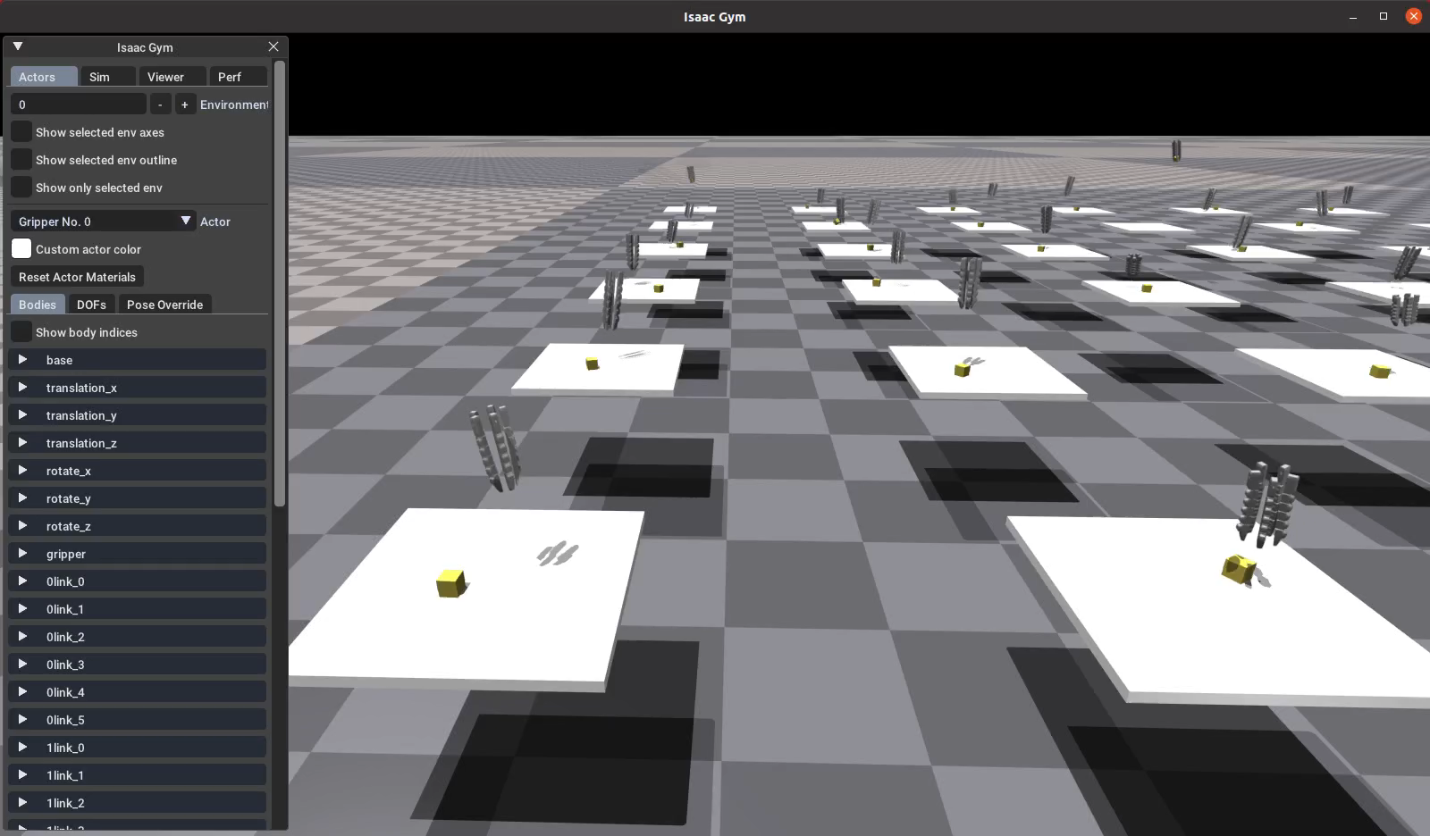
Different finger configurations
4-fingered gripper
2-fingered gripper
→ Use different objects to train
5-fingered gripper

Slide 5
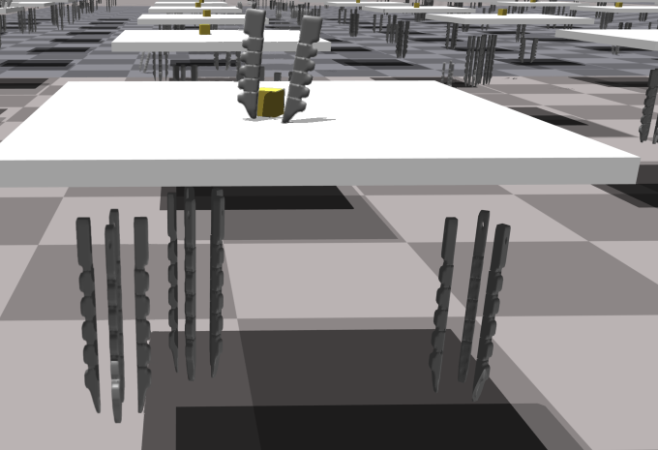
Multiple gripper configuration
Update on environment set-up
- Load different types of finger configuration into each environment: from 2 to 5-fingered gripper
- Observations:
+ Object pose, object id
+ Pose for the base of all types of grippers
+ number of DOFs
→ Loading 3-fingered and 4-fingered gripper in each environment
self.env_indices_3f = torch.arange(0, self.num_envs, 2)
self.env_indices_4f = torch.arange(1, self.num_envs, 2)
gripper_obs[self.env_indices_3f, :] = gripper_3f_obs[self.env_indices_3f, :]
gripper_obs[self.env_indices_4f, :] = gripper_4f_obs[self.env_indices_4f, :]

Slide 6
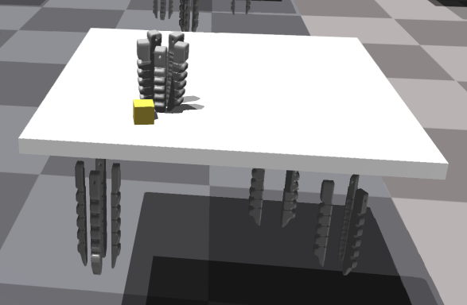
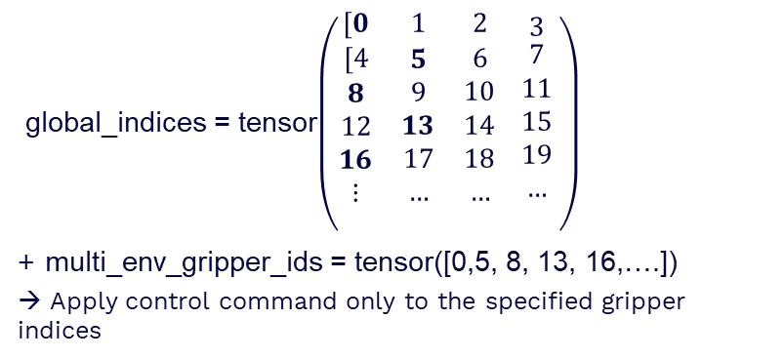
Multiple gripper configuration
Improvement
→ Solve the problem of resetting the environment
global_indices = tensor$\left(\begin{matrix}[0 & 1 & 2 \\ \begin{aligned}[4 \\ 8 \\ 12 \\ 16 \\ ⋮ \\ \end{aligned} & \begin{aligned}5 \\ 9 \\ 13 \\ 17 \\ … \\ \end{aligned} & \begin{aligned}6 \\ 10 \\ 14 \\ 18 \\ … \\ \end{aligned}\end{matrix} \begin{matrix}3 \\ \begin{aligned}7 \\ 11 \\ 15 \\ 19 \\ … \\ \end{aligned}\end{matrix} \right)$
+ multi_env_gripper_ids = tensor([0,5, 8, 13, 16,….])
→ Apply control command only to the specified gripper indices
Rewards:
+ Calculate individual reward for each gripper
+ rewards = rewards_3f.clone()
rewards [env_indices_4f] = rewards_4f[env_indices_4f]

Slide 7
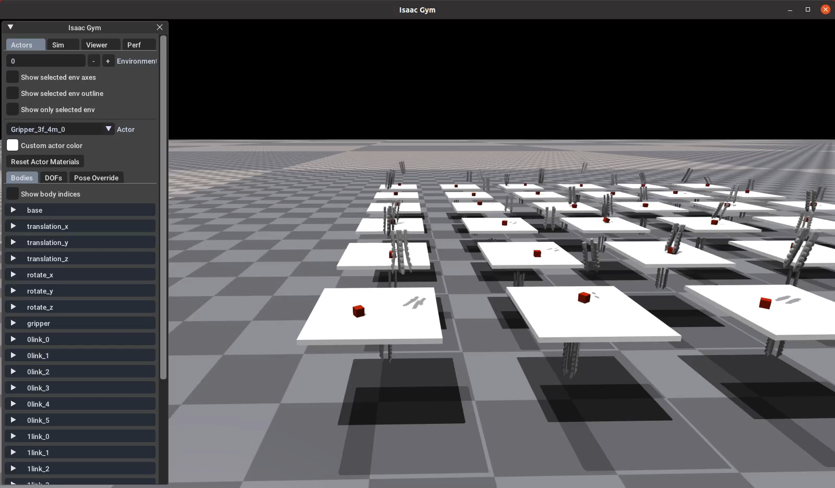
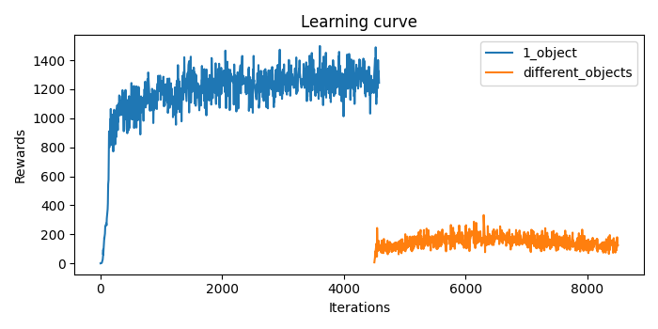
Multiple gripper configuration
Performance
- Switch from training a specific object to different objects → Low performance
→ Test success rates for different types of objects

Slide 8
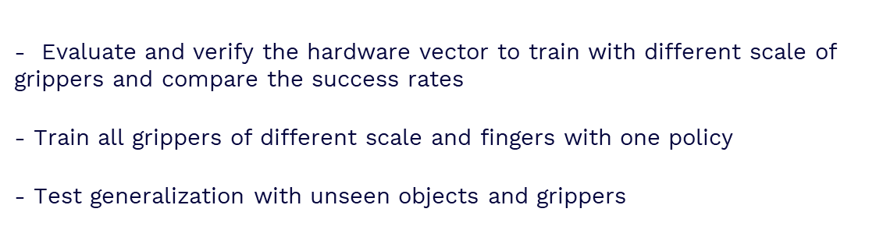
Future work
- Evaluate and verify the hardware vector to train with different scale of grippers and compare the success rates
- Train all grippers of different scale and fingers with one policy
- Test generalization with unseen objects and grippers

Slide 9
Thanks!

